Slide 1
Custom Queries
and
Migrations
Hibernate and Flyway DB

Slide 2
Content
Transaction Currency
CrudRepository
FlywayDB Migrations
Exercises

Slide 3
Currencies
Add Currency Entity => Columns [id, name]
Add Transaction <-> Currency Relationship
Currency Seeding
Add Currency Information To Transaction Endpoints

Slide 4
CrudRepository
public interface CrudRepository<T, ID> extends Repository<T, ID> {
<S extends T> S save(S entity);
<S extends T> Iterable<S> saveAll(Iterable<S> entities);
Optional<T> findById(ID id);
boolean existsById(ID id);
Iterable<T> findAll();
Iterable<T> findAllById(Iterable<ID> ids);
long count();
void deleteById(ID id);
void delete(T entity);
void deleteAll(Iterable<? extends T> entities);
void deleteAll();
}

Slide 5
Custom Repository Methods
a. We can start our query method names with find...By, count...By. Before By we can add expression such as Distinct . After By we need to add property names of our entity.
b. To get data on the basis of more than one property we can concatenate property names using And and Or while creating method names.
c. If we want to use completely custom name for our method, we can use @Query annotation to write query.

Slide 6
Custom Repository Methods
public interface UserRepository extends CrudRepository<User, Long> {
// Enables the distinct flag for the query
List<User> findDistinctPeopleByLastNameOrFirstName(String lastName, String firstName);
List<User> findPeopleDistinctByLastNameOrFirstName(String lastName, String firstName);
// Enabling static ORDER BY for a query
List<User> findByLastNameOrderByFirstNameAsc(String lastName);
List<User> findByLastNameOrderByFirstNameDesc(String lastName);
}

Slide 7
Spring Data JPA @Query
public interface UserRepository extends CrudRepository<User, Long> {
@Query("SELECT u FROM User u WHERE u.status = 1")
Collection<User> findAllActiveUsers();
}

Slide 8
Spring Data JPA @Query Native
public interface UserRepository extends CrudRepository<User, Long> {
@Query(
value = "SELECT * FROM USERS u WHERE u.status = 1",
nativeQuery = true)
Collection<User> findAllActiveUsersNative();
}

Slide 9
Database Migrations with Flyway
Flyway updates a database from one version to a next using migrations.
We can write migrations either in SQL with database specific syntax or in Java for advanced database transformations.

Slide 10
Flyway Maven Plugin
<plugin>
<groupId>org.flywaydb</groupId>
<artifactId>flyway-maven-plugin</artifactId>
<version>6.0.4</version>
<configuration>
<user>root</user>
<url>jdbc:mysql://localhost:3307/money-transfer-app</url>
<schemas>
<schema>money-transfer-app</schema>
</schemas>
<baselineOnMigrate>false</baselineOnMigrate>
</configuration>
</plugin>

Slide 11
Plugin Configuration
<configuration>
<user>root</user>
<url>jdbc:mysql://localhost:3307/money-transfer-app</url>
<schemas>
<schema>money-transfer-app</schema>
</schemas>
<baselineOnMigrate>false</baselineOnMigrate>
</configuration>

Slide 12
Migration Naming Convention
Format : <Prefix><Version>__<Description>.sql
Location: src/main/resources/db/migration
Example: V1_1_0__my_first_migration.sql
<Prefix> – Default prefix is V, which may be configured in configuration file using the flyway.sqlMigrationPrefix property.
<Version> – Migration version number. Major and minor versions may be separated by an underscore. Migration version should always start with 1.
<Description> – Textual description of the migration. The description needs to be separated from the version numbers with a double underscore.

Slide 13
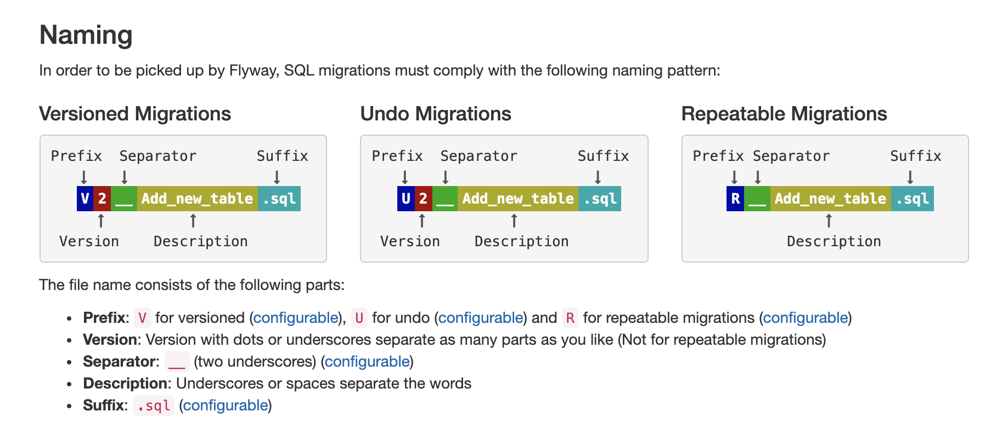
Naming Conventions

Slide 14
How Flyway Works
The framework performs the following steps to accommodate evolving database schemas:
It checks a database schema to locate its metadata table (SCHEMA_VERSION by default). If the metadata table does not exist, it will create one
It scans an application classpath for available migrations
It compares migrations against the metadata table. If a version number is lower or equal to a version marked as current, it is ignored
It marks any remaining migrations as pending migrations. These are sorted based on version number and are executed in order
As each migration is applied, the metadata table is updated accordingly

Slide 15
Commands
Flyway supports the following basic commands to manage database migrations.
Info: Prints current status/version of a database schema. It prints which migrations are pending, which migrations have been applied, what is the status of applied migrations and when they were applied.
Migrate: Migrates a database schema to the current version. It scans the classpath for available migrations and applies pending migrations.
Baseline: Baselines an existing database, excluding all migrations, including baselineVersion. Baseline helps to start with Flyway in an existing database. Newer migrations can then be applied normally.
Validate: Validates current database schema against available migrations.
Repair: Repairs metadata table.
Clean: Drops all objects in a configured schema. All database objects are dropped. Of course, you should never use clean on any production database.

Slide 16
Exercises
Add birthdate to user using Flyway DB
Add add user filtering endpoints
Find by firstname or lastname or email
Fetch top ten matching
Make parameters optional
Ignore case
Add transaction filtering logic by transaction id
Add transaction monitoring columns. They should be automatically saved
Created date
Modified date
Add active column to users table
Filter transactions by currency

Slide 17
References
https://www.baeldung.com/database-migrations-with-flyway
https://www.iban.com/currency-codes
https://www.concretepage.com/spring-5/spring-data-crudrepository-example
https://docs.spring.io/spring-data/data-commons/docs/1.6.1.RELEASE/reference/html/repositories.html
https://docs.spring.io/spring-boot/docs/current/reference/html/common-application-properties.html
https://www.baeldung.com/spring-data-jpa-query
https://docs.spring.io/spring-data/commons/docs/current/reference/html/#repositories.query-methods.query-creation

